Slide 1
Supermarket Stock Management System
Data Structures and Algorithms Final Project
compiled By: Misa Xirinda , Faith Chioma, Ellis Mapakama

Slide 2
Background
Supermarket is the place where people come and purchase their daily using products, so there is a need to calculate how many products are sold and generate the bill to customers, but also keep track of the stock in the market.
Supermarkets require high level of administration to keep the stock management efficient and well managed.

Slide 3

Problem Formulation
For small scale supermarkets who handle stocks with goods less than a few hundred thousand units oftenly use exercise books and notepads to record their stock goods.
This method takes a lot of time and books are easily destroyed by fire or water causing loss of all records.
Books do not offer security to this system since anyone can easily gain access and manipulate the records.

Slide 4

SOLUTION DESIGN

Slide 5
Data Structures Used
In order to come up with the perfect data structure for the system we had to look at what kind of data the the system we plan to make has to handle and what manipulations would be made to the data.
The Data:
product details (barcodes, name, quantity , price, date of purchase)
users (employeeID, name, passcode)

Slide 6
The Operations on the Data
Inserting, displaying, deleting, searching, decrementing quantities.
Data Structure used: Linked List
Since there is need to do more inserting than any other operation a linked list is more suitable to handle this task.
A linked list is dynamic , allows easy insertion and deletion & only allocates space that has to be used.

Slide 7
Below are the delivered by our system:
Add product
Show product
Delete product
Show a list of all the records in the database(csv)
Move goods from the warehouse into the shop

Slide 8
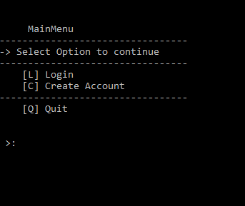
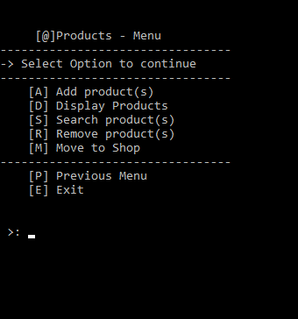
Functions
This Menu is for adding, deleting, displaying and moving products to the shop
The Main Menu has 2 major functions : Login and Create User Account

Slide 9
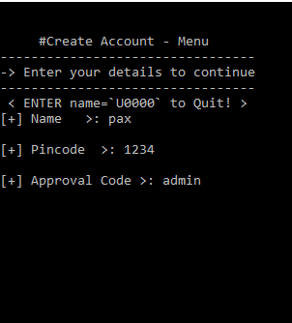
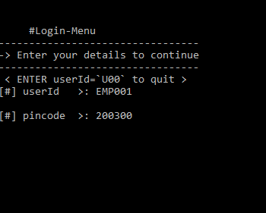
User Input
To create a user account choose the Create Account Option from the main menu and provide name and pincode.
The Employee Code that a user will use for logging in later is auto generated.
For Security Reasons a supervisor is needed so as to provide an Approval Code.
Logging in provide credentials (EmployeeID & Pincode)

Slide 10
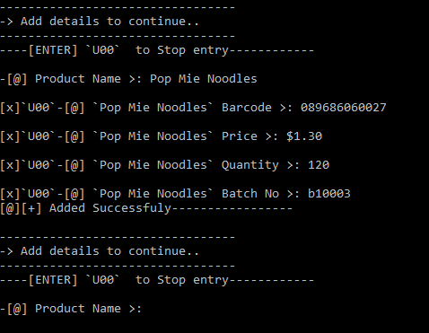
User Input
To add a product into the system ones to provide:
Product name, barcode, price, quantity & batch number. At any point if the users enter the string “u00” the adding process is stopped.
If all the details are supplied the record will be successfully added.
One can terminate adding by entering “u00” or continue adding records.

Slide 11
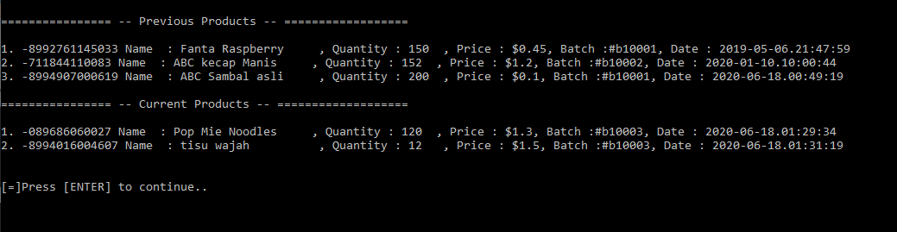
Expected Output
The screen above shows the kind of output that we get when you display all the products that have been saved in the system.
Each record has a barcode, prodect name, quantity, unit price, batch number and the date at which the product was delivered.

Slide 12
Work Plan And Timeline
24-28 April 2020 | Team-up/Construct ideas
29-30 April 2020 | Generate Project Proposal
1 May 2020 | Proposal Submission
2- 3 May 2020 | Research
4-10 May 2020 | Implementation/Progress Report 1
11-17 May 2020 | Implementation/Progress Report 2
4 May-7 June 2020 | Implementation
8-17 June 2020 | Last touches/ Testing
18 June 2020 | Presentation

Slide 13
Conclusion
Our program facilitates the management of stock in a supermarket and it is very helpful for admin or staff to easily keep track of the stock in the market.
This project has been successfully completed after a lot of effort, and it gave a lot of satisfaction to all of us.

